Slide 1
Exploiting Open Functionality in SMS-Capable Cellular Networks
William Enck, Patrick Traynor, Patrick McDaniel, and Thomas La Porta
Systems and Internet Infrastructure Security Laboratory
Department of Computer Science and Engineering
The Pennsylvania State University
University Park, PA 16802
Presenter: Suhrobjon Bozorov
Notes:
Hi everybody.
I am Suhrobjon Bozorov.
Today, I will be talking to you about a research paper on Exploiting Open Functionality in SMS-Capable Cellular Networks from William Enck, Patrick Traynor and et. al.

Slide 2
Introduction
SMS (Short Message Service)
voice and text messages
Even if voice calls are not possible
extremely popular with the telecommunication industry
Open functionality
Internet-originated text messages
contact mobile subscribers without use of a cell phone
has serious negative consequences
Deny voice service
Hit-lists
Zombie networks
Notes:
Firstly, let me introduce the SMS and its functionalities.
So, SMS (that is: Short Message Service) allows users to receive Voice and text messages. Even though voice call isn’t available, we can still use SMS, which makes it extremely popular within the telecommunication industry.
When cellular network and Internet are connected, it gives us open functionality.
In turn, this allows us to send Internet-originated text messages to mobile subscribers.
It means that users can contact mobile subscribers without the use of a cell phone.
However, the Open functionality has serious negative consequences for cellular networks.
This paper shows that an adversary can deny voice service by using large, highly accurate phone hit-lists or Zombie network.

Slide 3
SMS/CELLULAR NETWORK OVERVIEW
Sending
Mobile device or ESME
External Short Messaging Entities (ESME)
Delivering
Short Messaging Service Center (SMSC)
SMS formatting
Queued for forwarding
Query Home Location Register (HLR) for directions
HLR
Subscriber Info, call waiting, text messaging
If user is busy, store SMS for later
Otherwise give address for MSC
Mobile Switching Center
ESME or devices
Internet
SMSC
Network
MSC
HRL
Notes:
The majority of mobile phone subscribers are able to receive
both voice and alphanumeric text via SMS transmissions.
As I mentioned earlier, we can send SMS even if voice calls are not available.
SMS sending process starts from ESME that is External Short Messaging Entities.
ESME are web-based messaging portals at service provider websites to voice mail services.
Messages are then delivered to a server that handles SMS traffic known as the Short Messaging
Service Center (SMSC). There SMS may be formatted and queued for forwarding.
Then SMSC sends a request to the Home Location Register ( HLR) for determine the routing information for the destination device.
After that, HLR sends a request to the MSCs which are responsible for facilitating mobile device authentication,
location management for attached base stations (BS),

Slide 4
SMS/CELLULAR NETWORK OVERVIEW
ESME or devices
Delivering (Continued)
MSC
Service, Authentication
Location management for BS
Base Stations
Hand offs / gateway to PSTN
Public Switched Telephone Network
Query Visitor Location Register (VLR)
Returns Info when device is away from HLR
Forwards to correct BS for delivery
Internet
SMSC
Network
BS
VLR
MSC
HRL
Notes:
In turn, The MSC queries a database
known as the Visitor Location Register, which returns a local copy
of the targeted device’s information when it is away from its HLR.

Slide 5
SMS/CELLULAR NETWORK OVERVIEW
Notes:
This process can be explained in more detail with the following demonstration.
As it can be seen, messages are first delivered to a server that handles SMS traffic known as the Short Messaging
Service Center (SMSC).
Then SMSC sends a request to the HLR for determine the routing information for the destination device.
The MSC queries a database of the Visitor Location Register, and it returns a local copy of the targeted device’s information
After detecting location of mobile host, MSC sends SMS to Base Station. And base station deliver SMS to mobile host.
then all the layers of the process return the ACK response to the previous layer.

Slide 6
Air interface
Air interface
BS
Control Channel (CCH)
Traffic Channel (TCH)
Common Control Channel
Dedicated Control Channel
Paging Channel (PCH)
Random Access Channel (RACH)
Notes:
Air interface is divided into two parts. They are Control Channel (CCH) and Traffic Channel (TCH).
CCH is also divided into two parts. They are Common CCH and Dedicated CCH.
The Common CCH consists of logical channels including
the Paging Channel (PCH) and Random Access Channel
(RACH), and it is the mechanism used by the base station to initiate the
delivery of voice and SMS data.

Slide 7
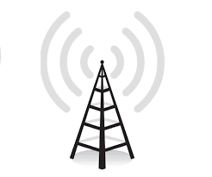
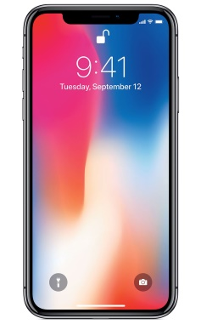
Air interface
MH1
Notes:
Now I will describe how base station delivers SMS to mobile host.
The base station notifies two mobile hosts (MH1 and MH2) of new
messages.
MH1 hears its identifier and responds to base station.
After authenticating and establishing an encrypted channel, the text message
is delivered over a dedicated control channel.
The SDCCH (that is: Stand alone Dedicated Control Channel) is used for most short transactions, including initial call setup step, registration and SMS transfer.
and I may say that all connected mobile devices are constantly listening to the Common CCH for voice and SMS signaling.

Slide 8
Vulnerabilities
Bottlenecks
System is a composite of multiple Queuing Points
Injection rate versus delivery rate
Targeting Queues
SMSC
Finite number in queue, SMS age, policy
Messages remain in SMSC buffer when device is full
Device
500 messages drained a battery
Notes:
By using the results of analysis, multiple vulnerabilities can be detected.
To find DoS vulnerabilities, the authors first identified bottlenecks
The system has multiple Queuing Points and adversary can attack one of them or all of them. As a result, attacker can deny system service.
And message injection rate can be more higher than delivery rate.
Using analysis, they actually identify vulnerabilities by finding Targeting Queues in SMS system.
If an adversary targeted to pending queue there are he or she can see limited number of queue in SMSC. If SMSC buffer is overfilled, after 90 minutes the buffer will be cleaned.
And if device is full, Messages will remain in SMSC buffer.
If we receive 500 SMS, our device battery will become drain.

Slide 9
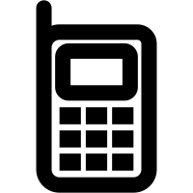
Gray-box Testing
Delivery Discipline
Checking SMSC and Mobile device capacity
Provider | SMSC Capacity
AT&T | 400
Verizon | 100
Sprint | 30
Model | Device Capacity
Nokia 3560 (AT&T) | 30
LG 4400 (Verizon) | 50
Tero 650 (Sprint) | 500
SMSC
No.1 ~ 400
messages
Notes:
Now I will describe about Gray-Box testing on Delivery Discipline.
Here we’re checked SMSC and Mobile device capacity.
In the left mail cloud, you can see the buffer capacity by checking the number of messages from 1 to 400, the prohibition indicator disappears -------------and how many times it starts when you turn on the lightning device.
On this table We can see Three of the most prominent service providers AT&T, Verizon, and Sprint. For each provider, 400
messages were serially injected at a rate of approximately one per
60 seconds. As the result it was detected SMSC’s buffer capacities.
Similar experiences were also made on mobile devices using the same provider, and buffer capacity of devices were determined

Slide 10
Attack plan
Messages exceeding saturation levels are lost
Successful DoS needs
Multiple subscribers
Multiple interfaces
Hit-lists and Zombies
Notes:
As it is well known, an attacker always has his plan.
An adversary firstly tries to overfill buffers for losing messages.
As I said, SMSCs buffer will be cleaned in every 90 minutes.
And he needs to delay delivering of messages more than 90 minutes.
For Successful DoS attack an adversary needs Multiple subscribers
and Multiple interfaces.
Multiple subscribers and Multiple interfaces generates by Hit-lists and Zombies

Slide 11
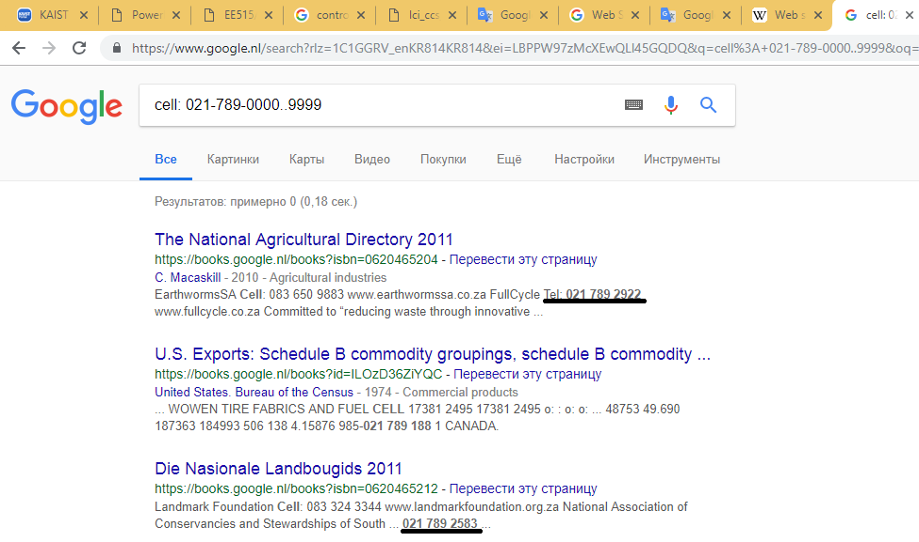
Hit-list Creation: Web Scraping
Search engine and scraping tools
Commonly used by spammers
Notes:
As I said For Successful DoS attack an adversary needs Multiple subscribers
and Multiple interfaces.
Web Scraping is a technique commonly used by spammers to
collect information on potential targets. Through the use of search
engines and scripting tools, these individuals are able to gather
email addresses, telephone numbers posted on web pages in an efficient, automated
fashion.
Here you can see simple query example of Web Scraping

Slide 12
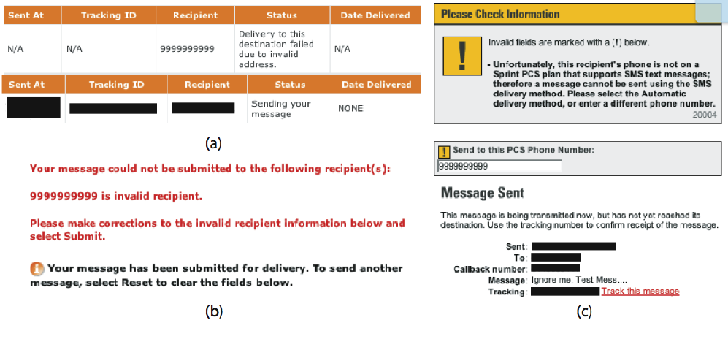
Hit-list Creation: Web Interface Interaction
Positive, negative response check
Notes:
Second way of Hit-list Creation it is Web Interface Interaction
If a message created through
Web interface is addressed to a subscriber of this particular provider,
the message is sent to the targeted mobile device and a positive acknowledgment
is delivered to the sender.
Otherwise, a negative acknowledgment is delivered to the sender.

Slide 13
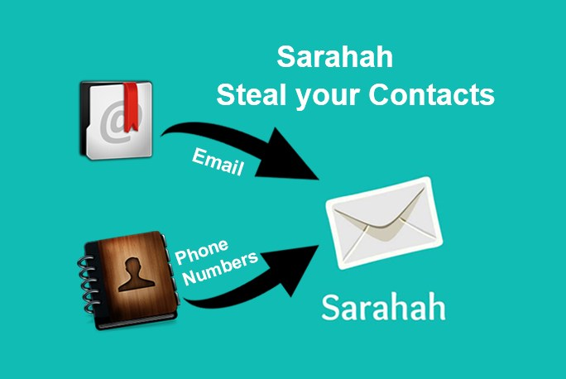
Hit-list Creation: Additional Collection Method
Device recently call lists
Stealing address book using worm
Notes:
We may use special applications for collect Device recently call lists or Stealing address book using worm as Additional Method of Collection useful data
For example Sarahah
Sarahah helps you in receiving constructive honest feedback while maintaining privacy.
But it can steal your Email and Phone contacts.

Slide 14
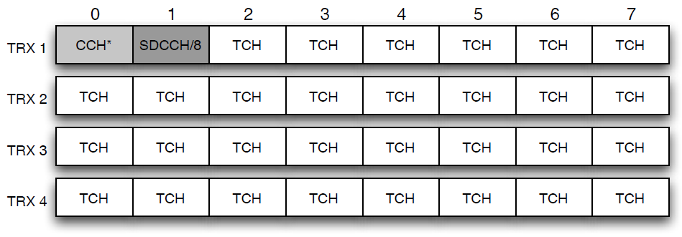
Metropolitan Area Service: GSM Air Interface
Timesharing system
Notes:
The GSM air interface is a timesharing system.
This technique is commonly employed in a variety of systems to provide an equal distribution of resources between multiple parties.
Each channel is divided into eight timeslots
Over the course of a multiframe, capacity for eight users is allotted.
The remaining time slots across all carriers are designated for voice data.
An adversary
can mount an attack by simultaneously sending messages through
the numerous available portals into the SMS network. The resulting
aggregate load saturates the control channels thereby blocking
legitimate voice and SMS communication.

Slide 15
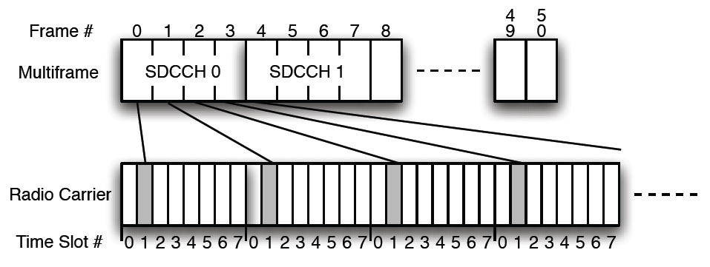
Metropolitan Area Service: GSM Air Interface
Notes:
the bandwidth within a given frame is limited, data (especially
relating to the CCH) must often span a number of frames
each SDCCH spans four logically consecutive
timeslots in a multiframe.
Timeslot 1 from each frame in a multiframe creates
the logical SDCCH channel.
In a single multiframe, up to eight
users can receive SDCCH access.

Slide 16
Area Capacity
Capacity can be calculated:
$\text{C}\text{ = (}\frac{\text{sectors}}{\text{area}}\text{)∗(}\frac{\text{SDCCHs}}{\text{sector}}\text{)∗(}\frac{\text{throughput}}{\text{SDCCH}}\text{)}$
Area Capacity for Manhattan city
Notes:
Before attack we need calculate SMS capacity of given Area
the maximum capacity of the system for an
Area calculated by this formula.
There C is the SMS capacity of given area.
First term describes all sectors per area. The Second term describes All SDCCH channels per sector and the Third term describes throughputs per area. By multiplying this definition we can know about SMS capacity of given Area.
In the following table, it’s given Required upload bandwidth to saturate an empty network

Slide 17
Attack Scenario
2500 numbers in hit list
Average 50 message device buffer
8 dedicated channels, (D.C.)
1 message per phone every 10.4 sec
8.68 min to fill buffers
Notes:
for accomplish successful attack we need minimum 2500 numbers in hit list, average 50 message device buffer and 8 dedicated channels
We need send 1 message per phone every 10.4 sec
And after 8.68 minutes it becomes to fill buffers

Slide 18
Targeted Attacks
Fill the buffers, users loose messages
Data loss on some devices from overflowing
Read messages overwritten when new ones arrive (Nokia 3560)
Message delays due to overflowing
Campus alert messages- blocking?
Deleting junk SMS, accidentally delete good ones
Battery depletion
Notes:
While total network degradation attacks can occur, Internet attacks
can be targeted
This attacks are accomplished by flooding the user with a superfluous
number of messages
This results in one of three outcomes:
1. a buffer somewhere overflows and the message is lost,
As observed
with the Nokia 3560, when the buffer became full, any message
with content assumed to be known were automatically deleted
2. the message is delayed longer than its shelf-life, or the user does not notice the
message due to the deluge of meaningless messages.
3. During the testing we saw, where 400 messages were injected to determine the size
of the SMSC buffers, the delivery of all packets took almost 90
minutes even with the constant monitoring and clearing of phone buffers.
While deleting an immense number of text messages is taxing on
the user, the receipt of large amounts of
data consumes significant battery power.

Slide 19
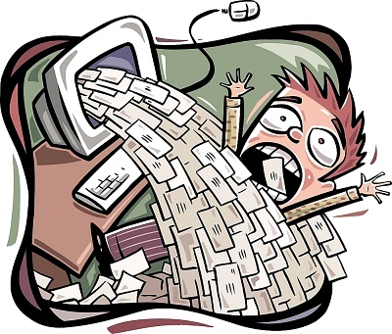
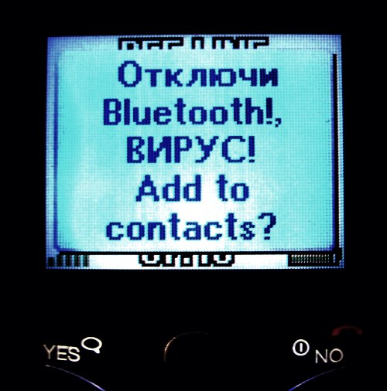
Tomorrows email
SPAM
Phishing
Viruses
Cabir and Skulls
Via Bluetooth
Notes:
Spamming is the use of messaging systems to send an unsolicited message (spam), especially advertising, as well as sending messages repeatedly on the same site.
Phishing is the fraudulent attempt to obtain sensitive information such as usernames, passwords and credit card details, often for malicious reasons, by disguising as a trustworthy entity in an electronic communication
A computer virus can infected or deny computer software's or hardware’s.
Viruses like Cabir and Skulls worms attempts to spread to other phones in the area using wireless Bluetooth signals.

Slide 20
Defenses
Separation of Voice and Data
Resource Provisioning
Rate Limitation
all web interfaces should limit the number of recipients
making interface closure
Education
Educate users (Inevitable phishing)
Notes:
There has many defenses against attacks on cellular network.
First of them Separation of Voice and Data. But it done in 3G
Second solution is Resource Provisioning. We can do this by applying additional base stations and MSCs in the area
The next solution is rate limitation.
The means of this solution are limiting number of recipients for all web interfaces and making interface closure between the web and cellular networks
The last solution is Educate user.

Slide 21
Related works
National Communications System. SMS over SS7. Technical Report Technical Information Bulletin 03-2 (NCS TIB 03-2), December 2003.
Cisco Systems Whitepaper. A study in mobile messaging: The evolution of messaging in mobile networks, and how to efficiently and effectively manage the growing messaging traffic. Technical report, 2004.
S. Byers, A. Rubin, and D. Kormann. Defending against an internet-based attack on the physical world. ACM Transactions on Internet Technology (TOIT), 4(3):239–254, August 2004.
Notes:
In an attempt to understand the parameters leading to non-malicious, congestion-based DoS scenarios in a wireless environment, the National Communications System published a study examining the effects of SMS messages.
This study primarily focused upon problems caused by mobile to mobile communications and the lack of privacy users relying on email for SMS delivery
the Cisco Systems published a whitepaper about study in mobile messaging in 2004.
in this article described The evolution of messaging in mobile networks, and how to efficiently and effectively manage the growing messaging traffic
S. Byers et. al. demonstrated the ability to use simple automated scripting tools to register an individual for large volumes of postal junk mail.
And they analyzed internet-based attacks on physical world and they demonstrated defenses against this attacks in their research.

Slide 22
Contributions
Security impact of SMS on Cellular network
Deny service to city sized area
System Characterization
the resilience of cellular networks to elevated messaging loads
Refining Target Search Space
hit-lists
Defenses
Notes:
The authors contributions are given below.
First of this contributions is Security impact of SMS on Cellular network
Second contributions is Demonstrated deny service to city sized area.
After analysis of publicly available cellular standards and gray-box testing, characterized the resilience of cellular networks
to elevated messaging loads
Possibility of successful DoS attack by generating and using large and high accurate hit-lists
And finally given defenses against this attack

Slide 23
Summary
Cellular networks are critical part of
Social and economic infrastructures
Potential misuse from external services
DoS
InfoWar
Economic
Notes:
As a conclusion I can say that Cellular networks are a critical part of the economic and social infrastructures in which we live.
With additional resources, cyberwarfare attacks capable of denying voice and SMS service to an entire continent are also feasible.
this proved by example Washington DC and Manhattan cities in this research
But I think , the issues presented in this paper should be resolved in order to maintain these essential services.

Slide 24
Works After This Work
Serror, J., Zang, H., & Bolot, J. C. (2006). Impact of paging channel overloads or attacks on a cellular network. Proceedings of the 5th ACM Workshop on Wireless Security - WiSe ’06.
Patrick Traynor, Patrick McDaniel and Thomas La Porta. On Attack Causality in Internet-Connected Cellular Networks. USENIX Security Symposium, 2007
Patrick Traynor, William Enck, Patrick McDaniel and Thomas La Porta. Mitigating Attacks on Open Functionality in SMS-Capable Cellular Networks. IEEE/ACM Transactions on Networking, Vol. 17, No. 1, February 2009
Patrick Traynor, Michael Lin, Machigar Ongtang, Vikhyath Rao, Trent Jaeger, Patrick McDaniel and Thomas La Porta. On Cellular Botnets: Measuring the Impact of Malicious Devices on a Cellular Network Core. CCS’09, November 9–13, 2009
Zhao, B. Y., Chi, C., Gao, W., Zhu, S., & Cao, G. (2009). A Chain Reaction DoS Attack on 3G Networks: Analysis and Defenses. IEEE INFOCOM 2009 - The 28th Conference on Computer Communications.
Notes:
if you have noticed that this article was published in 2005, and after this research many studies have been made in this area.
below I will focus on these researches.

Slide 25
Impact of paging channel overloads or attacks on a cellular network
Question
is whether actions or threats on the Internet side can impact the telecom or cellular side?
Distinction
approaches to gather the required information to carry out attacks and specific ways to carry out attacks
model and analysis specifically to CDMA2000 networks
Defenses
Not given
Notes:
First of them it is Impact of paging channel overloads or attacks on a cellular network by Serror, J and et.al. the authors of this paper addressed to this question is whether actions or threats on the Internet side can impact the telecom or cellular side?
Unlike the paper I explained you, the authors of this paper also discuss about approaches to gather the required information to carry out attacks and specific ways to carry out attacks.
Their model and analysis were specific to CDMA2000 networks
They demonstrated that the paging channel is vulnerable to overloads
But defenses against overload attacks on paging channel are not given in this paper

Slide 26
On Attack Causality in Internet-Connected Cellular Networks
two new vulnerabilities
low bandwidth DoS attacks
rigidity fails to adapt changing conditions.
the low-bandwidth exploits are not easy to be solved.
Notes:
The paper about On Attack Causality in Internet-Connected Cellular Networks by authors Patrick Traynor and et. Al illustrated the fundamental tension caused by the meeting
of best effort IP networks and the circuit-switched air interface of
cellular networks. However, such attacks were previously considered
to have originated from outside of the targeted network
They found two new vulnerabilities to demonstrate low bandwidth DoS attacks that can block legitimate cellular traffic
And they showed that without fundamental change in cellular data network design, the low-bandwidth exploits are not easy to be solved.

Slide 27
Mitigating Attacks on Open Functionality in SMS-Capable Cellular Networks
Goal
maintain the high availability of voice telephony
Cellular network is vulnerable to
SMS-based attacks
Worms
Countermeasures
Queue Management Scheme
Resource Provisioning
Notes:
The next paper about Mitigating Attacks on Open Functionality in SMS-Capable Cellular Networks by authors Patrick Traynor and et.al.
The goal of authors this paper was to maintain the high availability of voice telephony required by regulatory bodies while attempting to provide maximal throughput for high-value text messaging.
cellular networks are in fact quite vulnerable
to SMS-based attacks mounted by adversaries with even limited
resources.
Systems less directly connected to the Internet have also been subject to attack by worms. Because of worms can scatter easily and fast on network.
This work provides some preliminary solutions and analysis for these vulnerabilities.
they believed that these techniques (Queue Management Scheme and Resource Provisioning)c an eliminate or extensively mitigate even the most intense targeted text messaging attacks

Slide 28
On Cellular Botnets: Measuring the Impact of Malicious Devices on a Cellular Network Core
Contributions
flooding attack on an HLR
first investigation of attack on the core of a cellular network
Mitigation
Filtering
Can be aggressive because call forwarding is not critical
What if call forwarding is not the transaction used?
Shedding
How to deploy effective rules during an attack?
Make phone security better
Notes:
In this paper, I was demonstrated that even
relatively small botnets composed entirely of mobile phones pose
significant threats to the availability of these network.
They demonstrated attacks against Cellular Network Core by flooding attack on an HLR. And it was first investigation of attack on the core of a cellular network.
after evaluating possibilities of attacks authors demonstrated countermeasures against this attacks.
They are: Filtering, Shedding and make phone security better.

